Slide 1
Prediction of Multi-Class Peptides by T-cell Receptor Sequences with Deep Learning
Phi Le, PhD and Li Zhang, PhD
University of California San Francisco

Slide 2
Presentation Outline
Background & Introduction
Materials & Methods
Results & Discussions

Slide 3
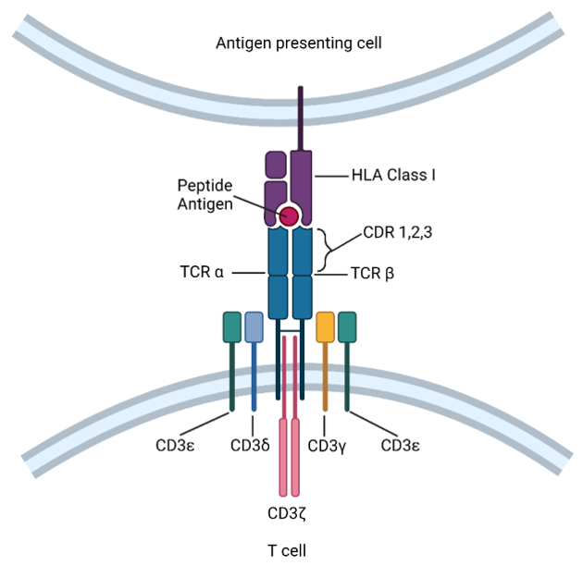
Background
TCRs attach to foreign antigens presented by MHC (HLA in human)
TCR-peptide recognition leads to T cell activation
Motivation: Understanding how TCR-peptide binding works is the key to immunotherapy and disease treatments
Research Question: Building computational biology tools to study TCR-peptide binding
Notes:
Spend brief time
Idea:
we have TCRs, hard to get antigen sequences
We have some other disease pairs. Most antigens came from virus
Project focuses on prediction which TCRs can bind to a list of antigen peptides from an interested diseases
Use pairwise TCR-antigen from databases to benefit the TCR antigen binding prediction

Slide 4
Primary Goal
Our goal is to provide an analysis tool that can estimate the probability of TCR binding to a specific peptide.
Notes:
Spend brief time
Idea:
we have TCRs, hard to get antigen sequences
We have some other disease pairs. Most antigens came from virus
Project focuses on prediction
Use pairwise TCR-antigen from databases to benefit the TCR antigen binding prediction

Slide 5
Feature Engineering – Sequencing Embedding Module
Notes:
Main purpose of this project
Atchley Factor Vectorization Task
Convert raw sequences to numerical vectors
Sequence Embedding Module
Reduce noises and extract underlying information from the original TCR sequences to boost prediction
Output the TCR encoded features, i.e. PE, ED
Graph Embedding Module
Use the information from TCR sequence similarity to improve prediction
Output the TCR node embeddings (NE)
Categorical Embedding Module
Encode HLAs and VJ genes as numerical vectors
Reduce noises and output the abstracted HLA and VJ features

Slide 6
Next: Autoencoders

Slide 7
Next: Encoder Decoder

Slide 8
Next: Graph Neural Networks

Slide 9
Feature Engineering – Categorical Encoding Task
Notes:
Main purpose of this project
Atchley Factor Vectorization Task
Convert raw sequences to numerical vectors
Sequence Embedding Module
Reduce noises and extract underlying information from the original TCR sequences to boost prediction
Output the TCR encoded features, i.e. PE, ED
Graph Embedding Module
Use the information from TCR sequence similarity to improve prediction
Output the TCR node embeddings (NE)
Categorical Embedding Module
Encode HLAs and VJ genes as numerical vectors
Reduce noises and output the abstracted HLA and VJ features

Slide 10
Bayesian Fully-connected Feed Forward

Slide 11
Results & Discussions

Slide 12
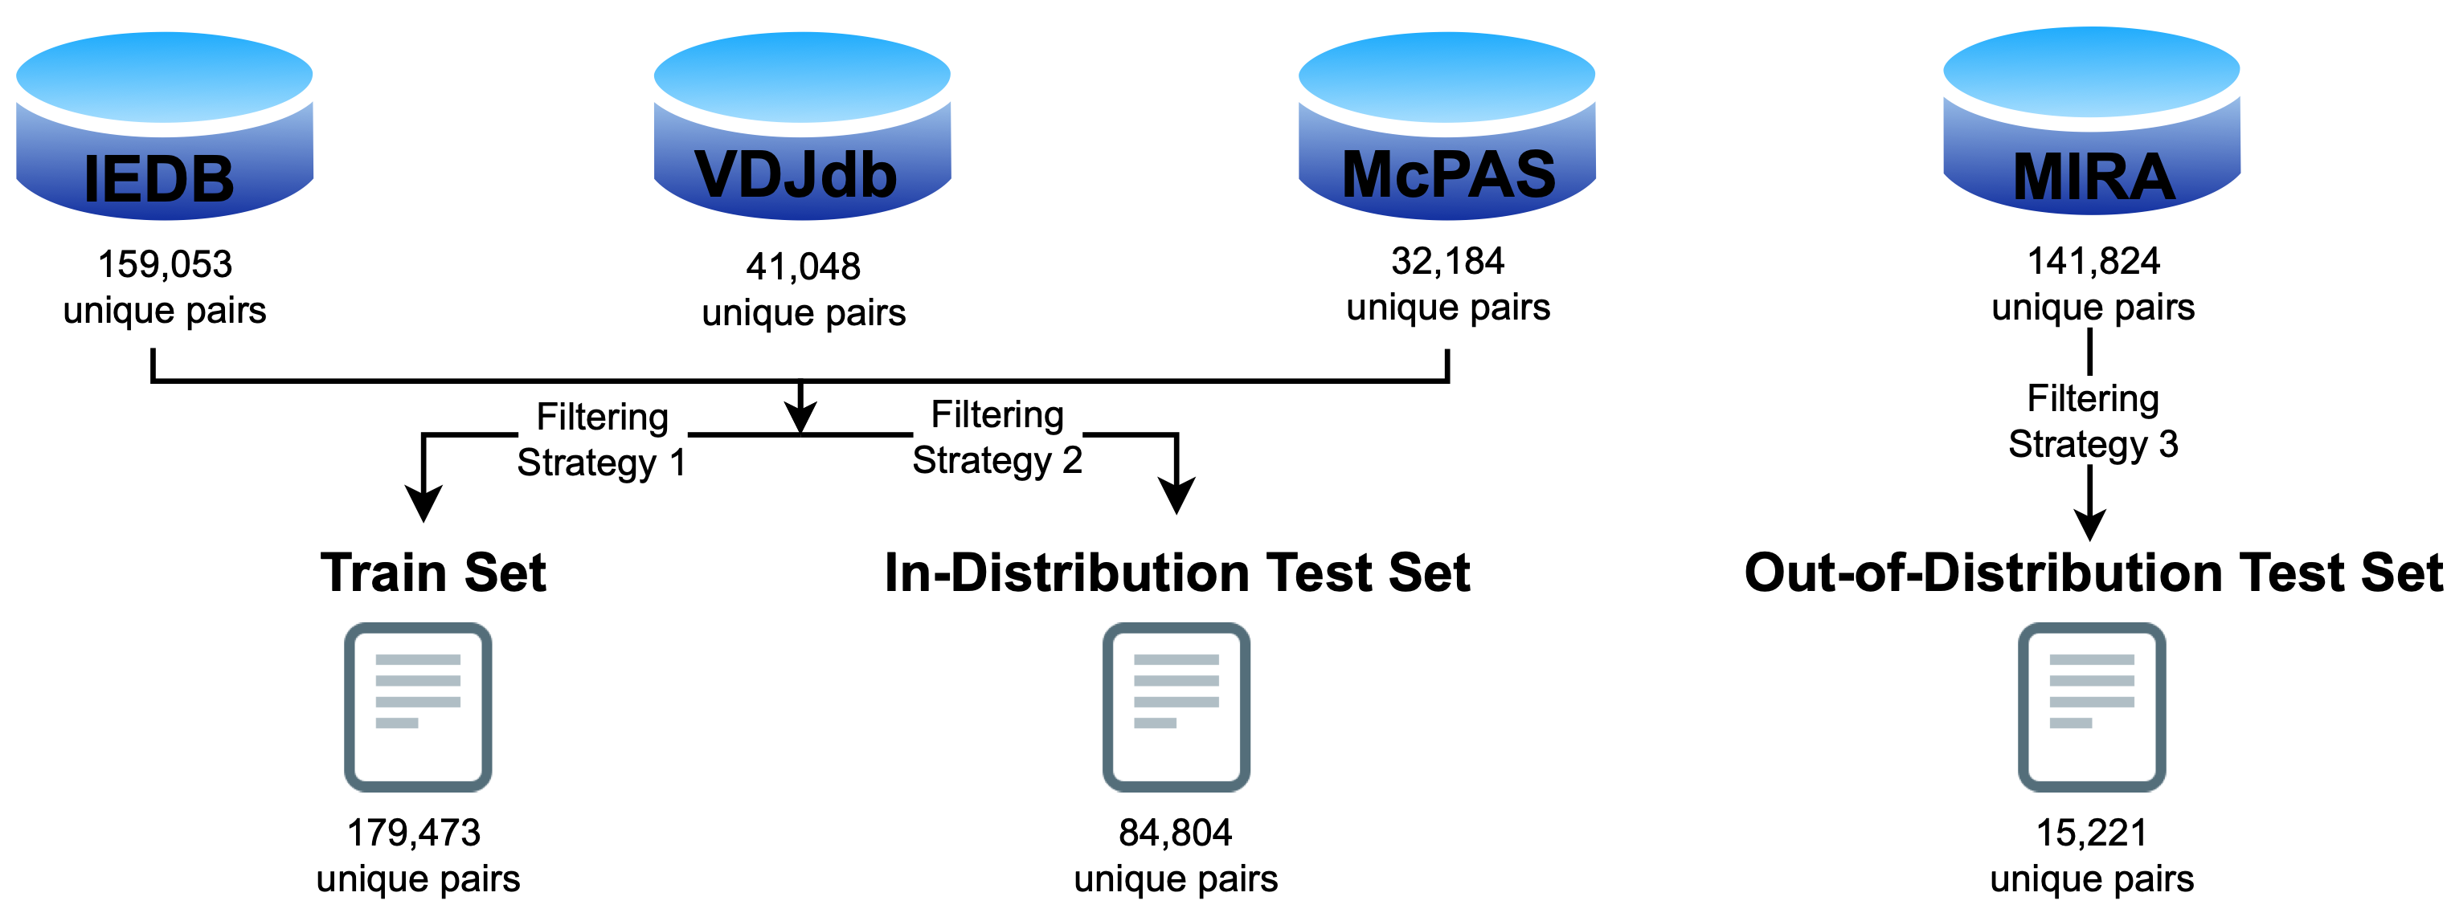
Data source from public databases
Notes:
In-distribution refers to data that is similar to feature engineering training data.
It comes from the same distribution or domain. It is the data that the model has been exposed during feature engineering training
Advantage:
the model becomes familiar with the patterns, structures and characteristics of the sequences present in the training data
Make accurate predictions and provide meaningful results/insights
Out-of-distribution refers to data that is different from feature engineering training data
It comes from a different distribution or domain. The data is unfamiliar to the model because it was not included in the training process
Represents the data that the model encounters in the real-world scenarios
tcr/peptide sequences from different organisms,
novel peptide variants
sequences with unique properties that were not present in the training data
Challenges:
may not learn the relevant patterns or structures required to make accurate predictions or (provide reliable results in the unfamiliar scenarios
Briefly mention ED model

Slide 13
In Distribution Data: Prediction Performance
Notes:
Talk about the first 4:
Tessa is benchmark for current use
PE uses TCR without training
Adding ED improves precision which is increasing True positive predictions
Adding network improves
Talk about next block of NE:
Adding NE to PE improves by 20%
Adding NE to ED improves by 15%
Adding HLAs:
Adding VJs
How about combining all

Slide 14
In Distribution Data: Robustness of Varying Number of Classes

Slide 15
Conclusions and Discussion
Comparing with the existing method, Tessa, our methods PE and ED perform similar or better.
Network features can improve the prediction accuracy.
Prediction performance is improved when adding NE, HLA, and VJ to PE, ED, especially for HLA.
Excellent performance in cases with class imbalance.
Robustness with varying number of peptides.

Slide 16









Acknowledgements
Li Zhang, PhD
Professor
UCSF
Bridget Keenan MD, PhD
Assistant Professor
UCSF
Lawrence Fong, MD
Professor of Medicine UCSF
David Oh MD, PhD
Assistant Professor UCSF
Tao He, PhD
Associate Professor SFSU
Cancer Immunotherapy Program at HDFCCC
Fong Lab, UCSF
Biostatistics Core, HDFCCC
NIH/NCI R21R21CA264381 (2021-2024)
NIH/NLM R01LM013763-01A1 (2022-2026)
UCSF Prostate Cancer Pilot Award (2021-2022)
Leah Ung, MS
Junior Specialist
UCSF
Hai Yang, MS
Senior Statistician UCSF
Brian Neal, MS
Student
UC Riverside
Anwen Huang
Student
UC Berkeley

